Slide 1


Salary packaging Module – SAP India
Global Payroll

Slide 2
Salary Packaging Module – Important Points
Total Compensation structure displayed on salary package screen is Flexible compensation plan (FCP) only and not total CTC.
Note that once you submit your Flexi declaration, tool will not allow you to change further.
If you do not submit your salary packaging before the due date, the existing salary package will be continued and accordingly the tax will be calculated.
Employees who are in the car lease scheme are requested not to change “Company Leased Car” component amount while updating your flexible compensation plan.

Slide 3
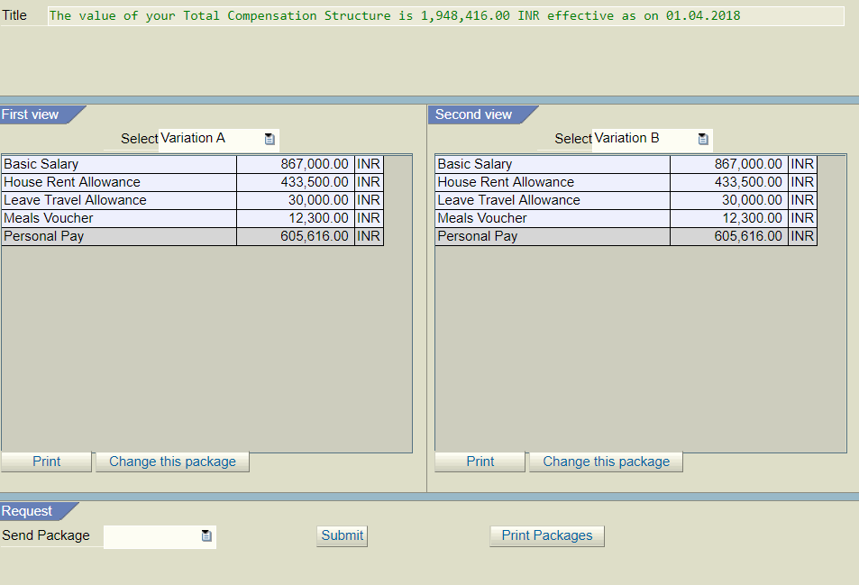
Salary Packaging Module – Screen 1
STEP 1 - You need to click on the link provided to get this screen. online declaration tool
Basic salary - Cannot be changed
Total FBP
Click here to Change Variation A
Click here to Change Variation B

Slide 4
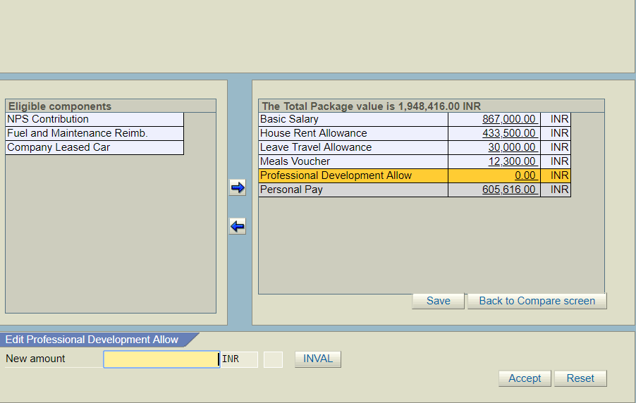
Salary Packaging Module – Screen 2
STEP 2 - You can select the desired components by using arrows.
STEP 3 - To change the value of a chosen component , click on the monetary field, Click on the field “New Amount” type the amount and click ‘Accept’
STEP 4 - When completed, click on “save” and than “back to compare screen” to continue
1. Click on the desired component
2. Use these arrows to move the components from left to right and vice versa
3. Click on the Monetary Field
4. Type the amount
5. Click on Accept to change the amount or Reset to change again

Slide 5
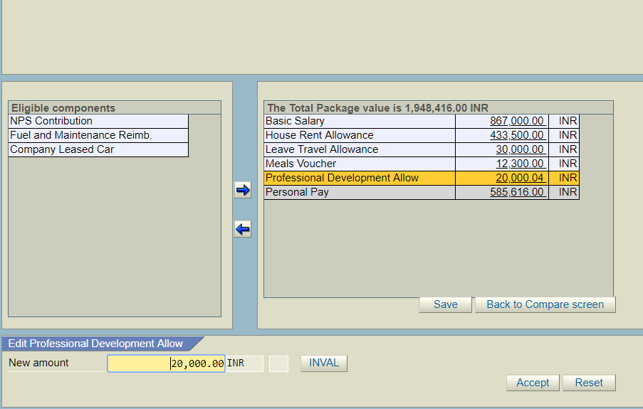
Salary Packaging Module – Screen 3
Note: - When completed, click on “save” and than “back to compare screen” to continue
2. Click on Back to Compare Screen to come-back & compare the variations
1. Click on Save before you click Back to Compare Screen

Slide 6
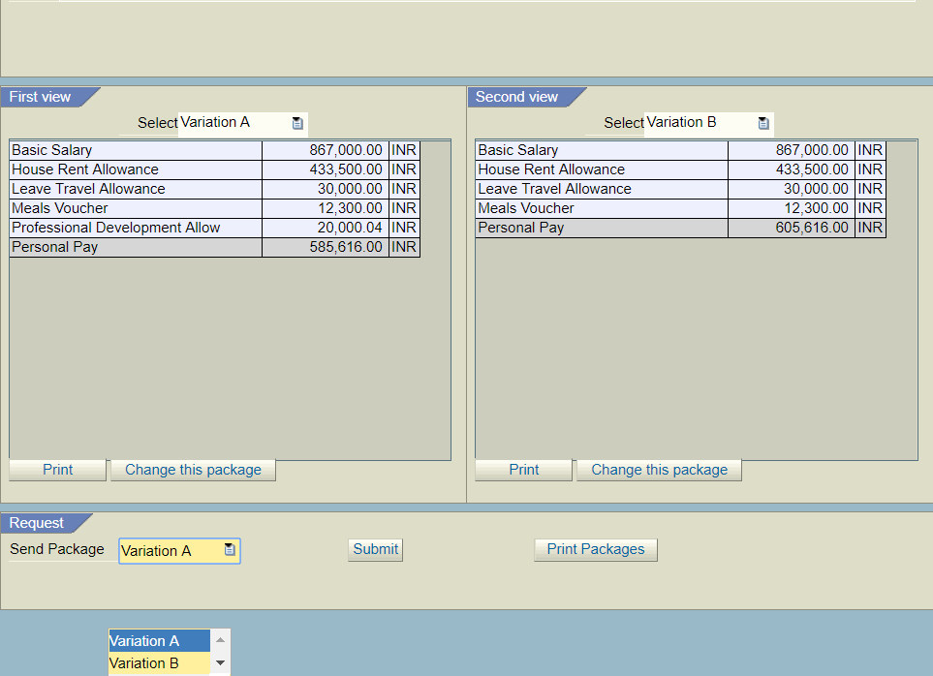
Salary Packaging Module – Screen 4
Click on submit to send your package to payroll
Select the package you want to submit

Slide 7
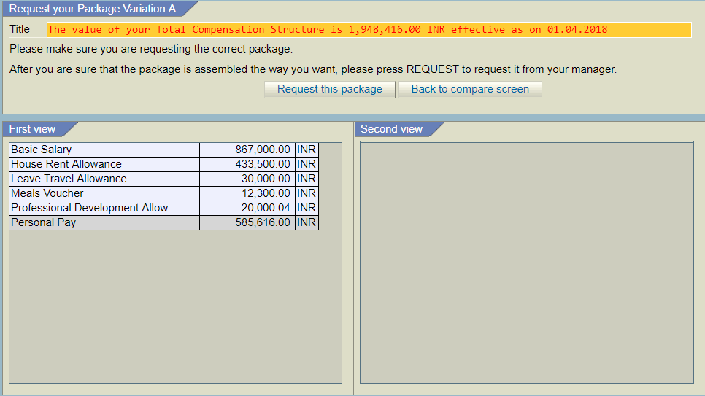
Salary Packaging Module – Screen 5
Click here to update the package into Payroll. This action cannot reverted and no option to change.

Slide 8
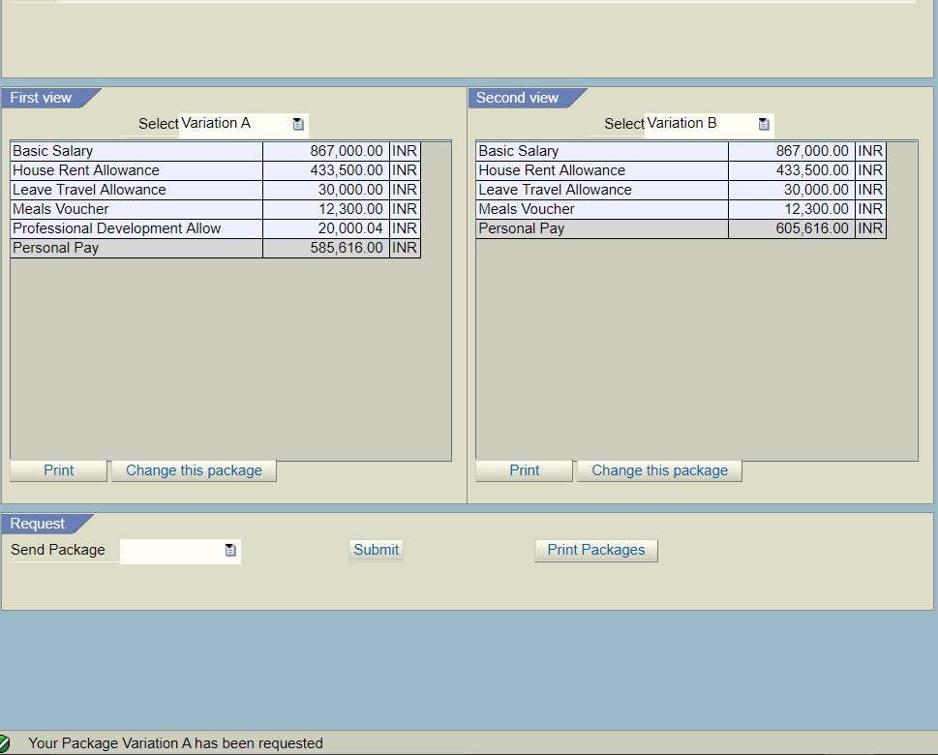
Salary Packaging Module – Screen 6
Pls check for the message below to make sure that your package has been updated to IPP
Take a screen shot of the same and save for your records to check the details when required in near future.

Slide 9
Thank You!
HRdirect ticket

